Slide 1

Segmenting and Clustering Districts in London
Capstone Project
by Helena Ferreira Pinto

Slide 2
INTRODUCTION
Explore London Districts
Clients: stakeholders interested in moving to London, UK

Slide 3
DATA
List of London postcode areas obtained from Wikipedia
Coordinates of London and the different postcode districts obtained using the Geocoder Python package
Number of venues and their category in every district area obtained using Foursquare API

Slide 4
METHODOLOGY
STEP 1: collect the required data (location and type (category) of the most common venues in London Districts)
STEP 2: calculation and exploration of 'venue frequency' across different district areas.
STEP 3: create clusters of locations that contain similar most common venues using Kmeans clustering.

Slide 5
ANALYSIS
Part 1: Web Scraping
Part 2: Geospatial Coordinates
Part 3: Explore and cluster the districts in London

Slide 6
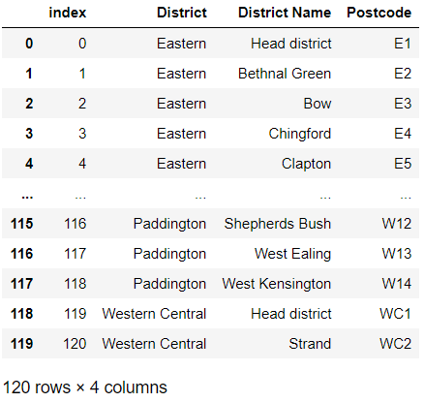
1- Web Scraping
Source: https://en.wikipedia.org/wiki/London_postal_district

Slide 7
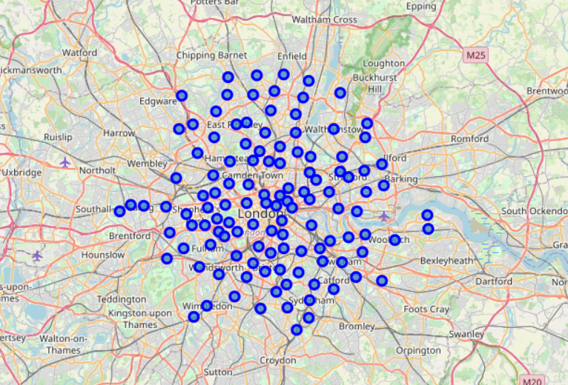
2- Geospatial Coordinates

Slide 8
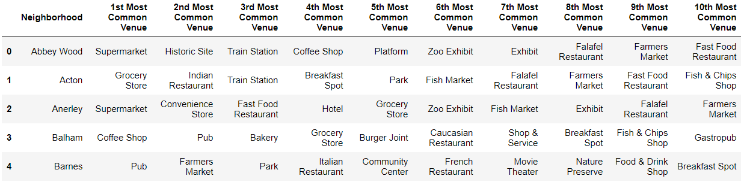
3- Explore and cluster the districts in London

Slide 9
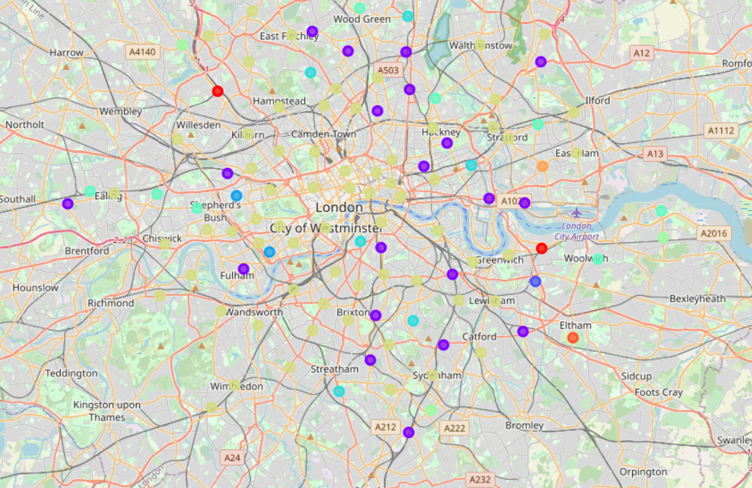
3- Explore and cluster the districts in London

Slide 10
RESULTS AND DISCUSSION
10 clusters
Refine the search after consulting the client
10 most common venues in each district
Further visualization using Heatmaps

Slide 11
CONCLUSION
Exploratory Data Analysis
Web scraping, Location data, Machine Learning

